Slide 1
Introduction to R
Part 1

Slide 2
First Note:
I am not an expert at R.
I’ve been hiking up the learning curve for about a year.
You can learn R.
You will get frustrated.
You will get errors that don’t help or make sense.

Slide 3
First Note:
Google is your friend.
Try googling the specific error message first.
Not the NaN one though, because ugh.
Then try googling your specific function and the error.
Try a bunch of different search terms.

Slide 4
First Note:
Helpful websites:
Quick-R: www.statmethods.net
R documentation: www.rdocumentation.org
TryR: tryr.codeschool.com
Swirl: www.swirlstats.com
Stack Overflow: www.stackoverflow.com

Slide 5
First Note:
Helpful text (for statistics):
Andy Field’s Discovering Statistics in R
Daniel Navarro Learning Statistics in R
This book is free online!

Slide 6
Get R
Download R from a CRAN mirror
http://cran.r-project.org/
Note:
Mac users will also need Quartz for plotting

Slide 7
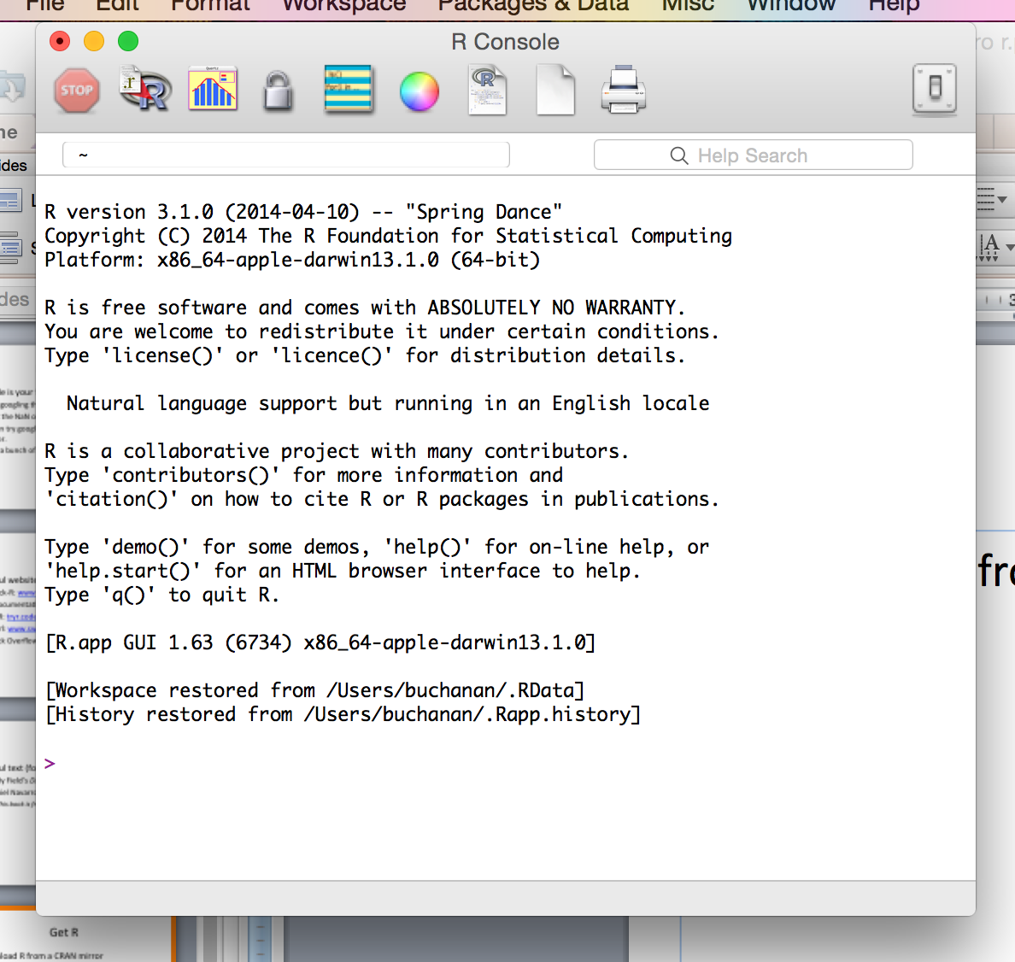

Slide 8
Get RStudio
For the love of sanity RStudio:
http://www.rstudio.org/

Slide 9
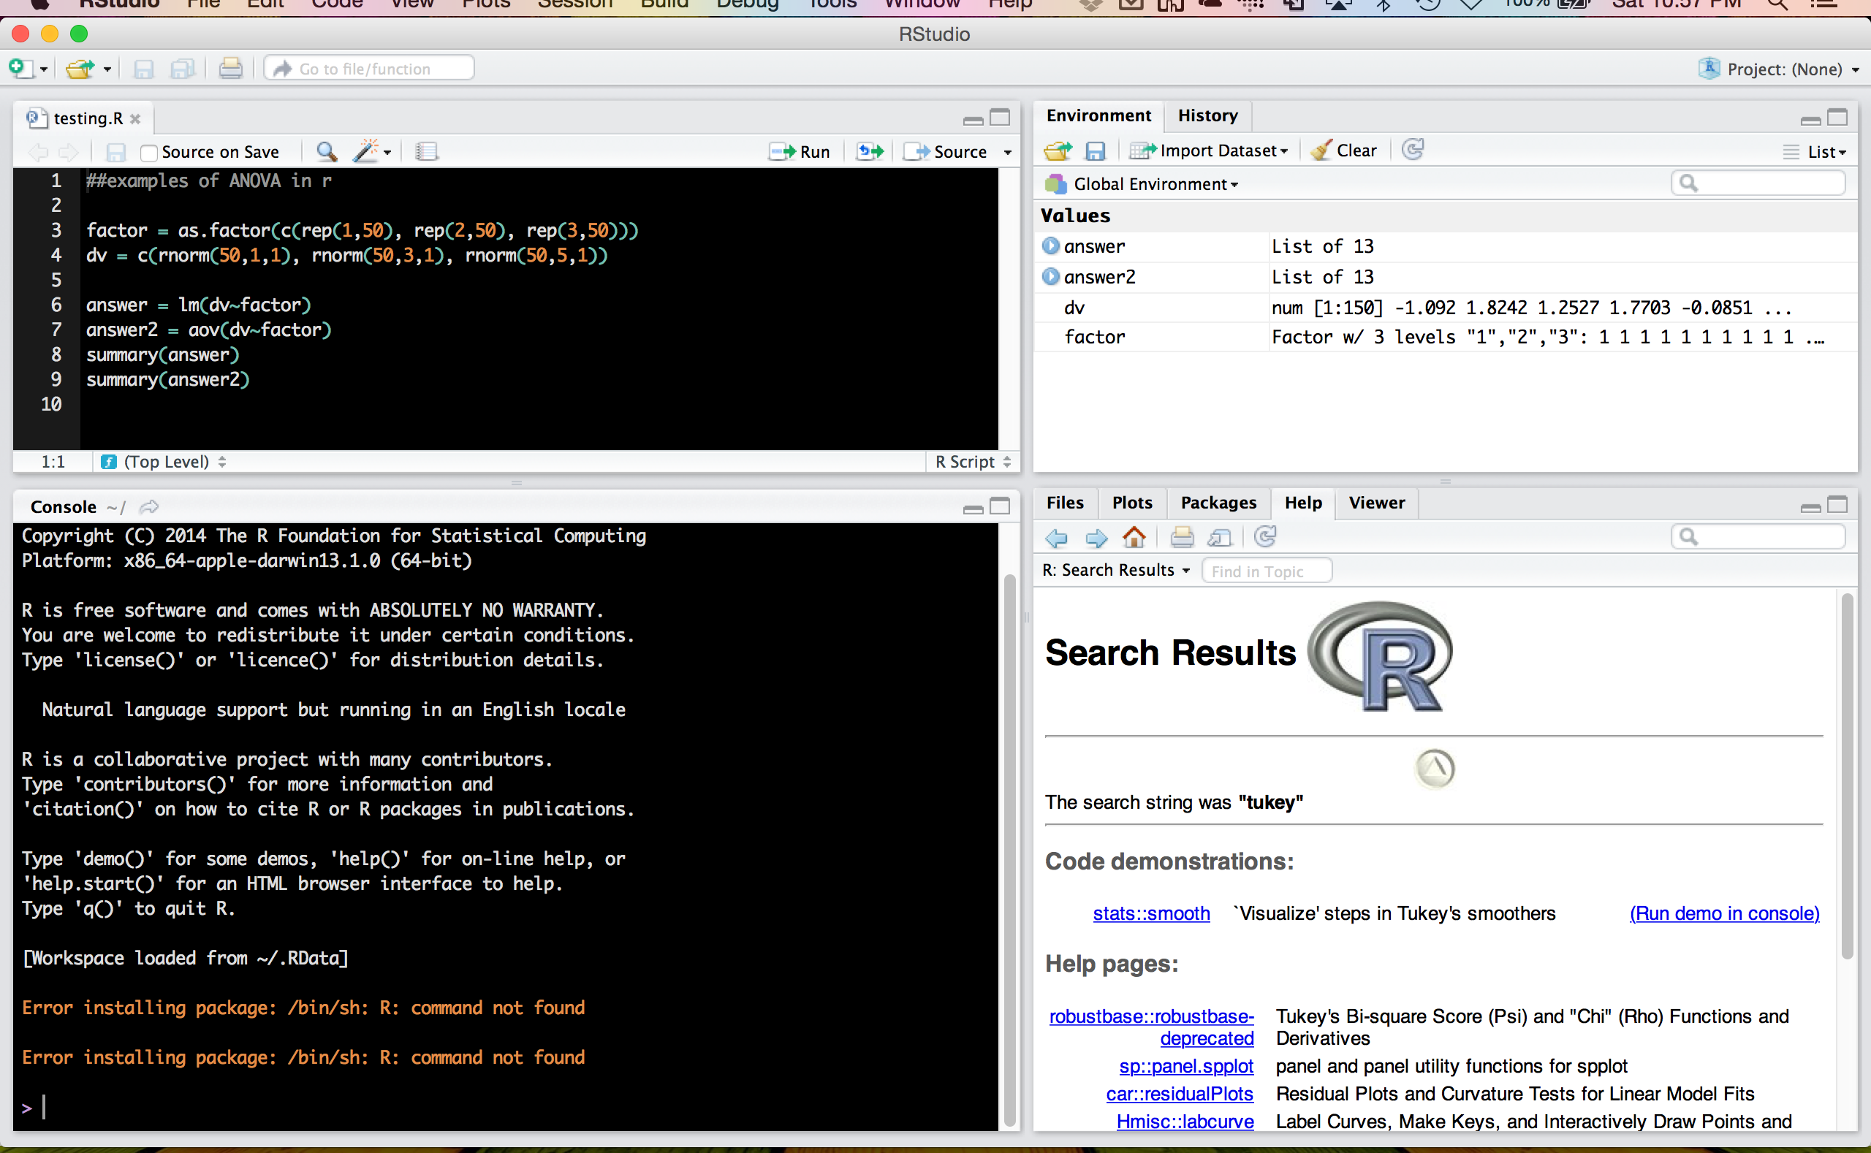

Slide 10
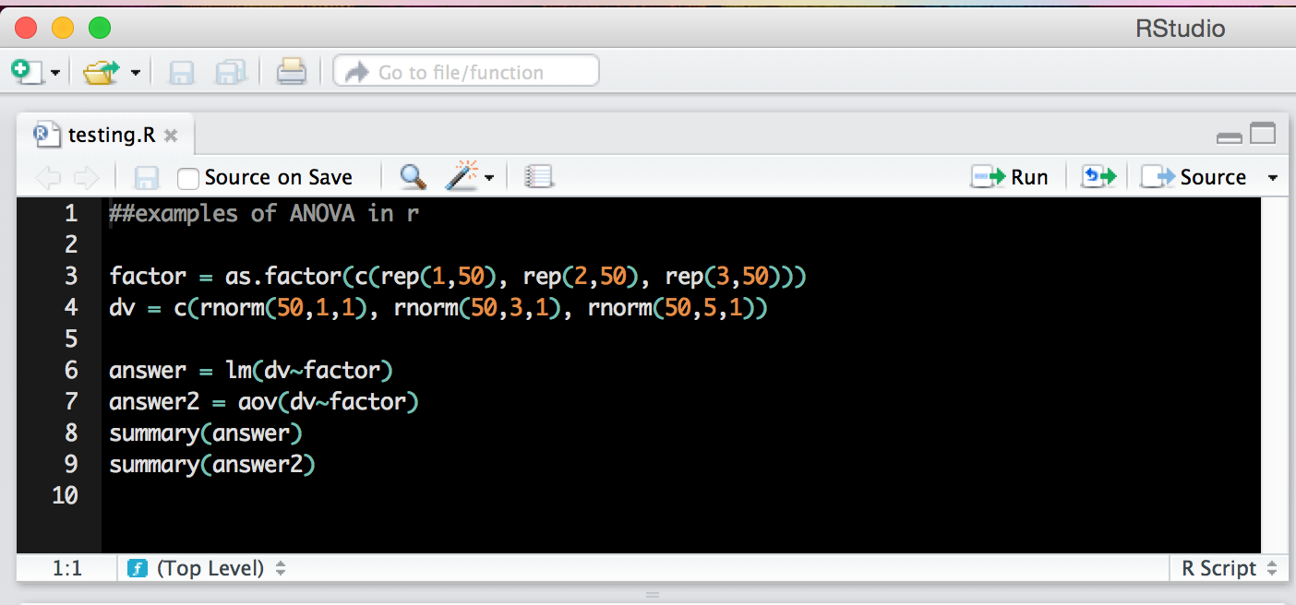
Top left window
Scripting window – these files end with .R extension.

Slide 11
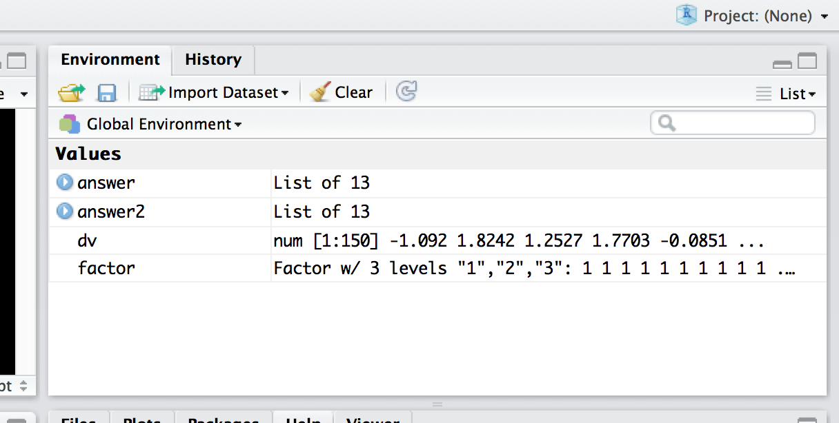
Top right window
Environment window – you can save the environment (variables, scripts, console) as
.Rdata files.

Slide 12
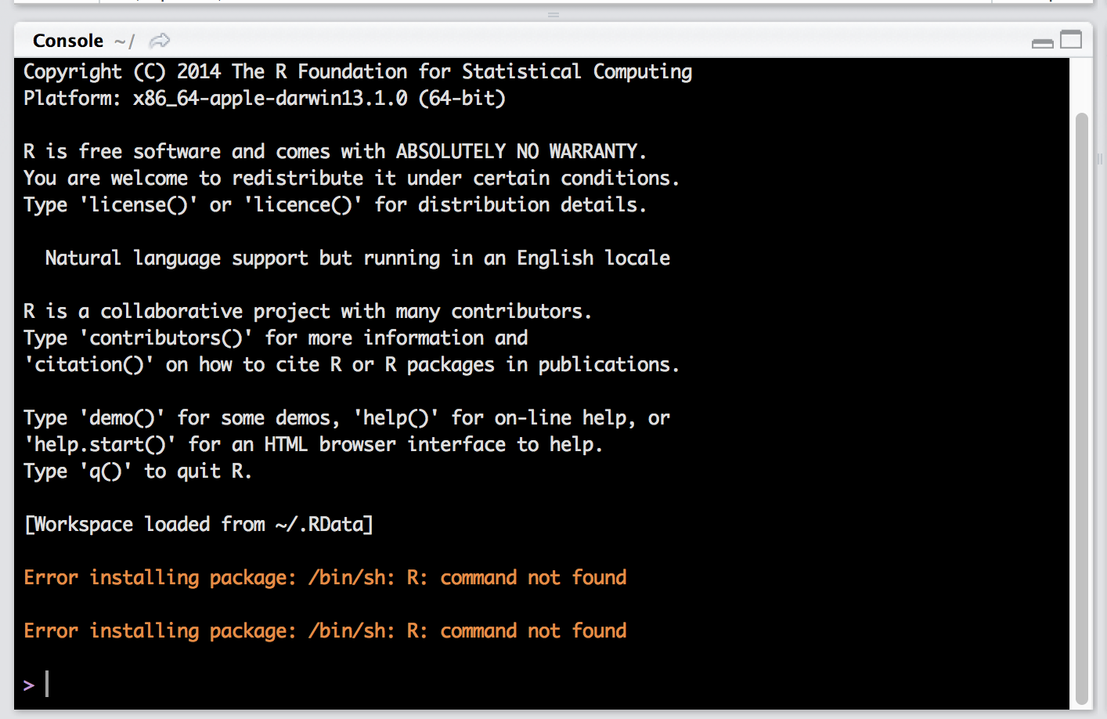
Bottom left window

Slide 13
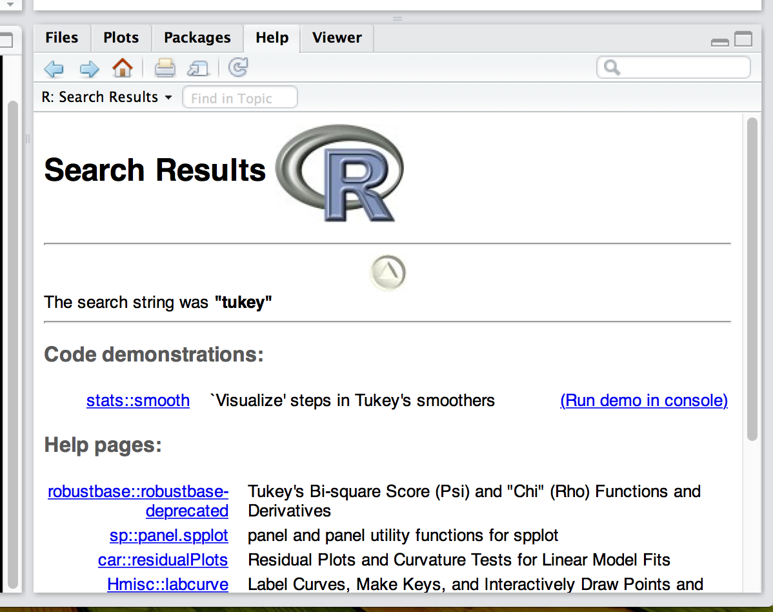
Bottom right window

Slide 14
Commands
Commands are the code that you tell R to do for you.
They can be very simple.
They can be very complex.
A note: R only does what you tell it. So when you encounter a mistake, it may be a typo or it may be an error in what you coded.

Slide 15
Commands
Commands can be typed in two places in RStudio.
At the top in an open R document.
Directly in the R console.

Slide 16
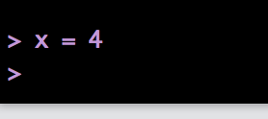
Commands
Try something simple in the console:
X = 4
What are the > signs?
Those indicate what has been run and a > with the cursor indicates it’s ready for the next command.

Slide 17
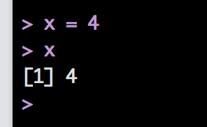
Commands
Now type X in the console (cApItAliZing matters!).
Now it shows you the value(s) of X.
It’s only one number: 4.
What is that [1] thing?! (give me a minute).

Slide 18
Commands
Note:
= and <- are equivalent.
In Swirl use <- to get credit.
An important thought here:
The question in R is never “can R do this?” it’s “how can R do this?”
(Un)fortunately, the answer is often: about 10 different ways.

Slide 19
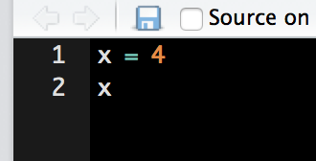
Commands
Now type the same thing into the R script window.
You should notice that nothing happened in the console.
The script window allows you to work on/save code without running it.

Slide 20
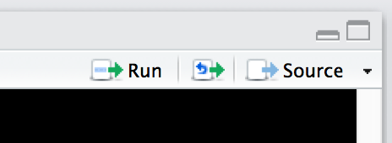
Commands
You can run the code by highlighting it and clicking on run or by hitting:
Windows: ctrl + r
Mac: command (apple) + return

Slide 21
Commands
The script window is great for saving projects so you can remember and recreate your steps when you need to later.
No need to save multiple files! ;)

Slide 22
Commands
Two console shortcuts:
Hit the up arrow – you can scroll through the last commands that were run.
Hit the tab key – you’ll get a list of variable names and options to select from.

Slide 23
Commands
So why RStudio?
SPSS is very visual, but R is not. You can certainly view the output and the data you are using, but if you don’t remember the variable names, it can be very daunting.
The top right window is your friend.

Slide 24
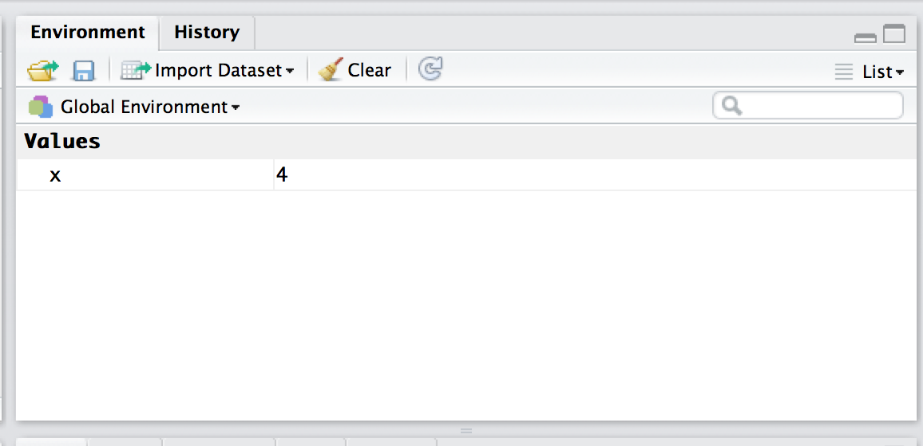
Commands
Anytime you create/use a variable, it will appear in the environment window.
You should have an X in that window now.

Slide 25
Commands
The environment window also allows you to see all the types of the variables you have open.
I find this very handy for lists and dataframes, which can be difficult to remember what all is stored in them.

Slide 26
Object Types
Vectors
Lists
Matrices
Data Frames

Slide 27
Object Types
Within these objects, values can be:
Character
Numeric/Integer/Complex
Logical
NaN (versus NA)

Slide 28
Object Types
And furthermore, within objects you can have attributes
The most important that you’ll use are their names
Example:
After you run a regression, you can get a variable that has the residuals and coefficients stored. They are stored with specific names, so you can call them.

Slide 29
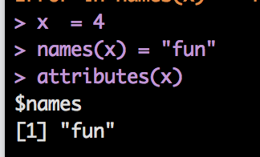
Object Types
Example
attributes(OBJECT NAME)

Slide 30
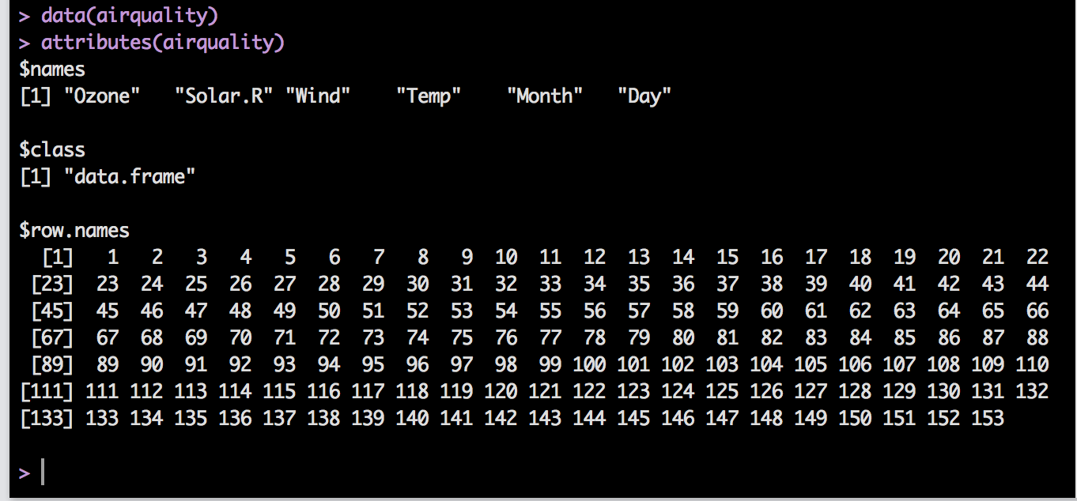
Object Types

Slide 31
Object Types
Another way to see what’s going on with an object:
ls(OBJECT NAME)
LS gives you a list of the names in an object.
str(OBJECT NAME)
STR gives you the structure of an object, which is helpful to know what things are stored in that object.
It’s the same thing you can see in the environment window.

Slide 32
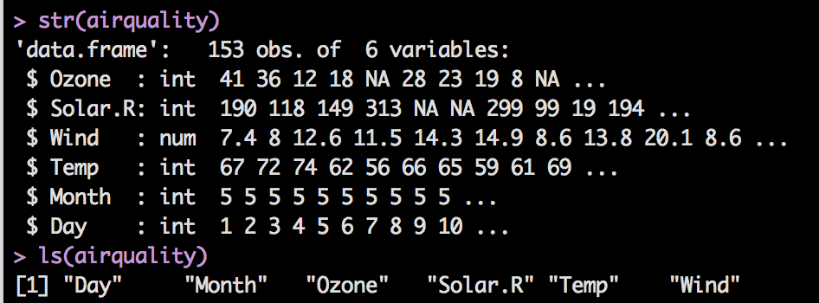
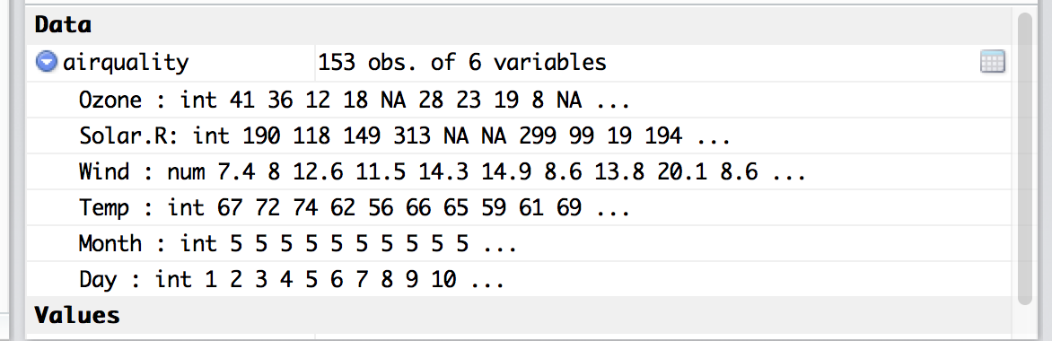
Object Types

Slide 33
Object Types
Vectors
You can think about a vector as one row or column of data
All the objects must be the same class/type (number, logical, etc.).
If you try to mix and match, it will coerce them into the same type or make them NA if not.
Think about: SPSS does this with characters as well.

Slide 34
Object Types
Let’s make a vector.
You’ve already done that! Go you!
X = 4, makes a vector.
X
That vector has one value (hence the [1] when you print it out) and is a class type numeric.

Slide 35
Object Types
Let’s make some more vectors! Learn four new things:
A = 1:20
B = seq(1, 20, 2)
C = c(“cheese”, “is”, “great”)
D = rep(1,30)

Slide 36
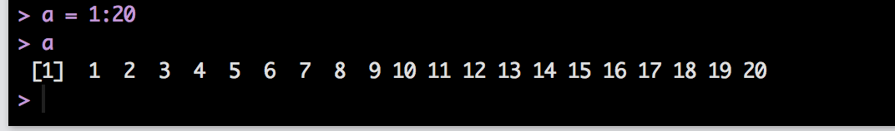
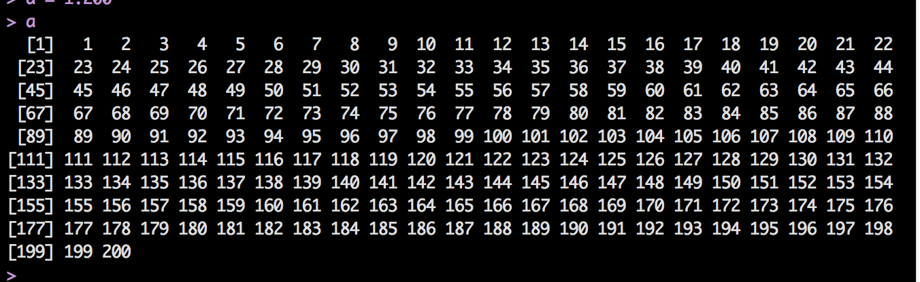
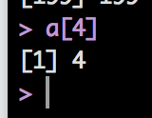
Notice you got a sequence of 20 numbers with intervals of 1.
The [1] doesn’t mean 1 row of data, it means here’s item number 1.
Try a = 1:200.
Now you see that the [] corresponds to the item placement in the vector.
Try typing a[4].

Slide 37
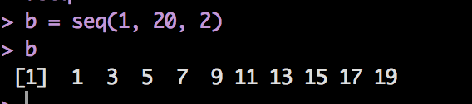
The sequence function works in the following way:
Seq(start, end, by)
Start at the number 1
End at the number 20
Increment by 2

Slide 38
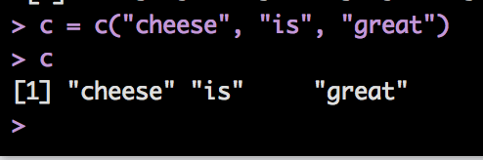
The c function = concatenate or combine.
This function lets you combine things into one vector.

Slide 39
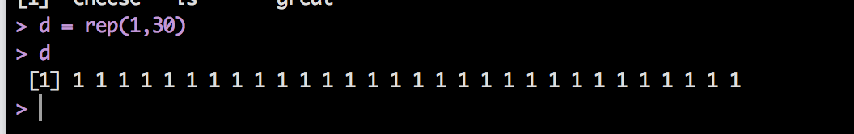
The rep function lets you repeat an object over and over.
rep(repeat this, so many times)
Try rep(1:4, 10)
You can combine all of these functions to get the exact sequences you need.

Slide 40
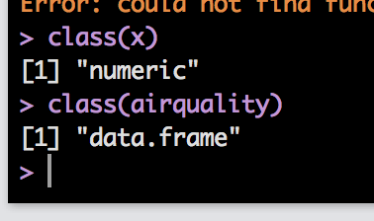
Object Types
Some things to try with vectors:
Class(OBJECT NAME) – tells you the type of data stored or the type of object if you are working with things bigger than vectors.

Slide 41
Object Types
Some things to try with vectors:
Length(OBJECT NAME): tells you the number of things in that object.
That can be tricky though – the length of a vector is the number of objects, but the length of a list/data frame is the number of things in a list, not the number of items of each sub variable.
I.E. it’s kind of like the number of columns in SPSS, not the number of participants.

Slide 42
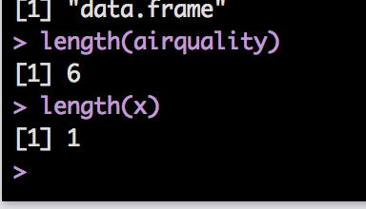

Slide 43
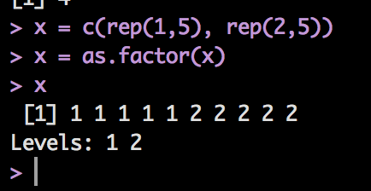
Object Types
Factors
Remember dummy coding in SPSS?
R does it for you! Yeah!
Use the as.factor(OBJECT NAME) command.
Let’s make a vector:
X = c(rep(1,5), rep(2,5))
X = as.factor(X)
You can also use text.

Slide 44
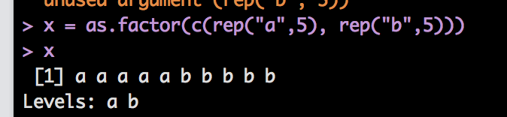
Object Types

Slide 45
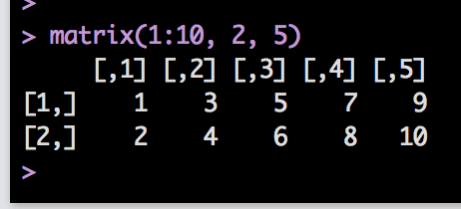
Object Types
Matrices
Matrices are vectors with dimensions (like a 2X3).
You can create a matrix with the following:
matrix(things to put into the matrix, rows, columns)
matrix(1:10, 2,5)
Notice it filled in the numbers going down.

Slide 46
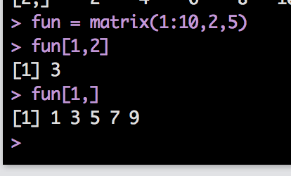
Object Types
Now what are the [,1] and [1,]?
Matrices are called by listing [row, column]
If you all one row or all one column:
fun[1, ]
Leave the indicator blank, and it will assume you want ALL of them.

Slide 47
Object Types
What if I want to combine things?
You can’t use c(row, row) – c is for vectors because there’s only one row.
You can use:
cbind(column, column)
rbind(row, row)
Let’s combine two vectors:

Slide 48
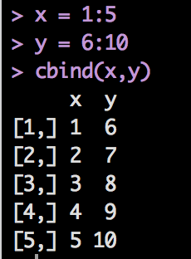
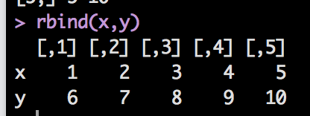
Object Types
X = c(1:5) (note x = 1:5 is the same thing)
Y = c(6:10)
cbind(x,y)
rbind(x,y)

Slide 49
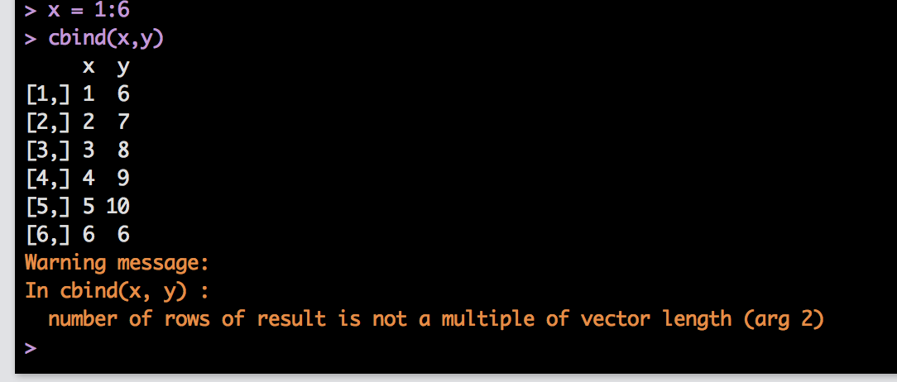
Object Types
Be careful when the objects are not the same length:

Slide 50
Object Types
Matrices are like vectors, everything must be of the same class/type (all numeric, all character, etc.)

Slide 51
Object Types
Data Frames are your friend
We will use these the most often.
They are special matrices, where everything must be the same length.
BUT the columns can be different classes.
So you can have characters, logicals, and numbers all together.

Slide 52
Object Types
Before talking about how to call values in a data frame, let’s talk about lists.
Lists are vectors that allow you to have different classes/types.
Lists are handy because they allow you to have different lengths of groups, unlike data frames.
You can create them with the list() function.

Slide 53
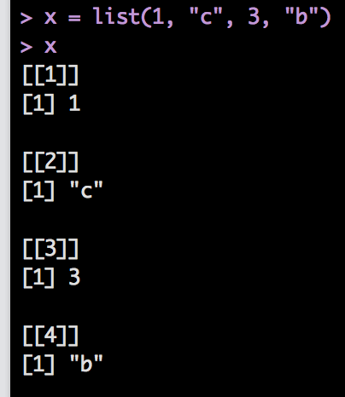
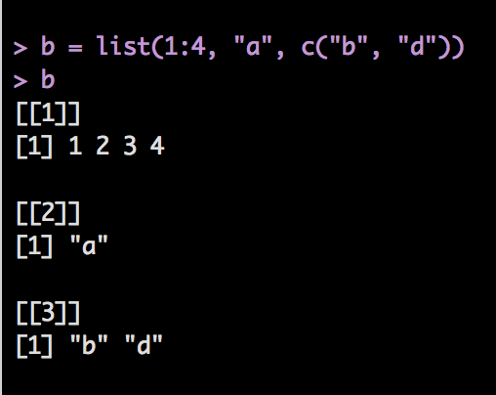
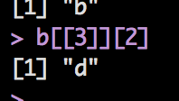
What’s with the [[]]?
[[]] indicates which number of the list the smaller vector is, while [] indicate which item in that smaller vector.
Try getting d out of the b list:

Slide 54
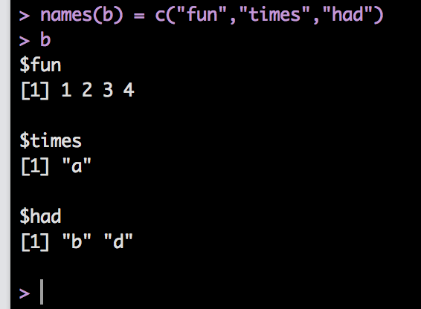
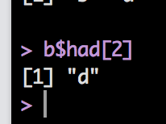
Object Types
Lists can also have names:
names(b) = c(“fun”, “times”, “had”)
Now try to get d out:

Slide 55
Object Types
Why even talk about lists when most of our data is going to be data frames?
When you save data from a function (like anova or regression), you will often get all the information from that function as a list.
It really helps to know how the heck to get the piece of information you need – especially when it’s not provided automatically with the summary function.

Slide 56
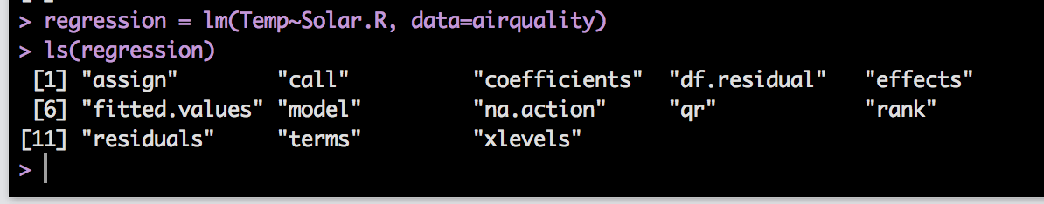
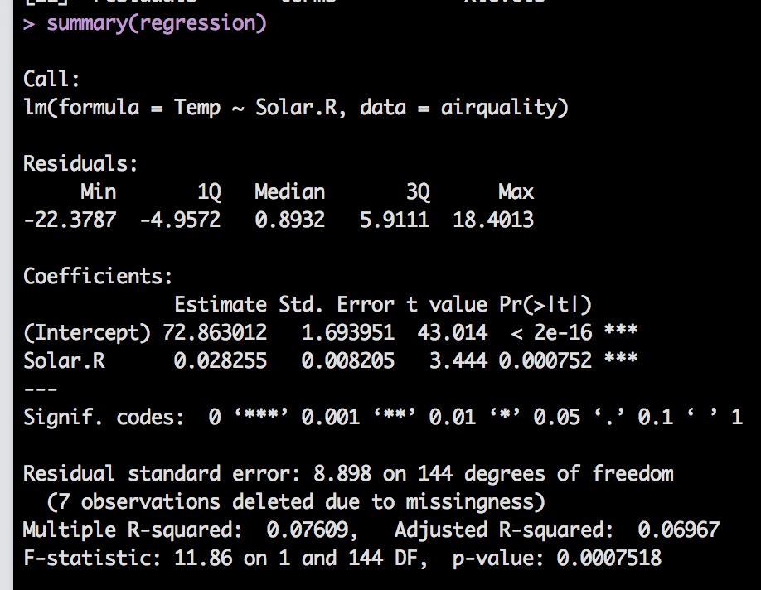
A quick example:

Slide 57
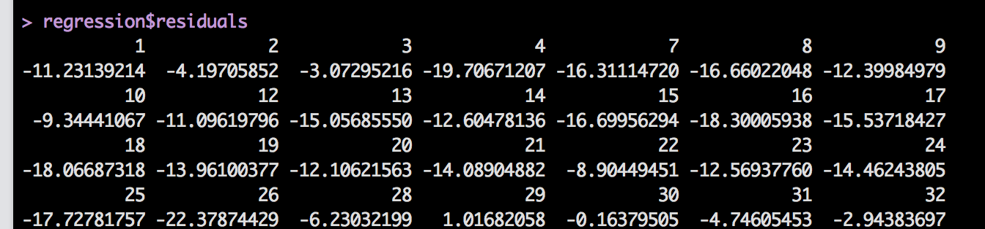
So what if you wanted the residuals?

Slide 58
Object Types
Now what is up with the $?
Lists and data frames are dimensional, so you can use the following to find something:
Lists: [[number]][number]
DF: [row, column]

Slide 59
Object Types
That’s tedious.
If they have names, you can use the $ to indicate the column (or sub-vector) name.
Therefore:
airquality$Temp and airquality[,4] are the same thing.

Slide 60
Object Types
REMEMBER:
Just because you know that the airquality dataset is open and Temp is a variable, doesn’t mean that R cares.
You must specify what object to look at for the Temp piece.

Slide 61
Object Types
You can also do the following:
with(OBJECT NAME, THING YOU WANT TO DO)
With applies the data frame/list name to all the variables you are using. It basically says “hey the stuff they want you to use is HERE”.
attach(OBJECT NAME)
Attach does the same thing, but it’s more permanent. It leaves that object open the whole time.
This version can get tricky if you have multiple things with the same name you are trying to use.

Slide 62
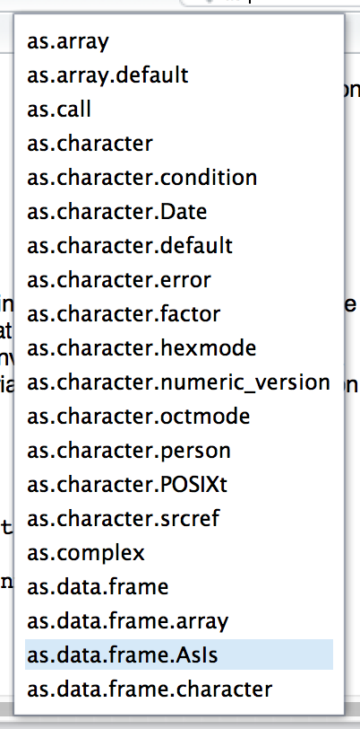
Object Types
Let’s say you want to change from one type to another:
as.data.frame
as.numeric
as.factor
as.logical
Etc.

Slide 63
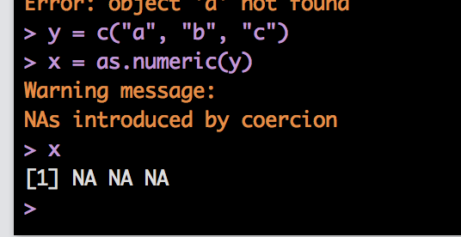
Object Types
Let’s make a character vector:
Y = c(“a”, “b”, “c”)
Try changing that to other types of data:
X = as.numeric(y)

Slide 64
Object Types
Summary: it’s good to understand types of objects, because it allows you to understand:
How to get to the information you need
Why you might be getting NaN or NA values
Etc.

Slide 65
Subsetting
Subsetting is pulling out the rows/columns that you need given some criteria.
We already talked about how to select one row/column with [1,] or [,1] and the $ operator.
What about cases you want to select based on scores, missing data, etc.?

Slide 66
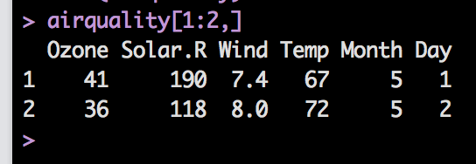
Subsetting
Examples
Let’s use the airquality dataset.
Pick out the first two rows of the whole dataset.
airquality[1:2,]
Remember that you can save each of these by setting them equal to a variable name.

Slide 67
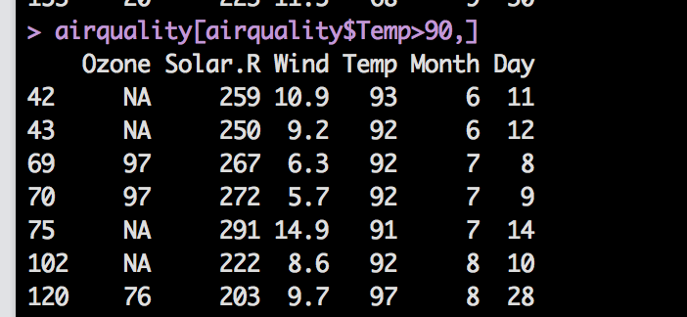
Subsetting
You can also use the logical operator to determine how to pick something.
Logical
airquality[airquality$Temp> 90,]

Slide 68
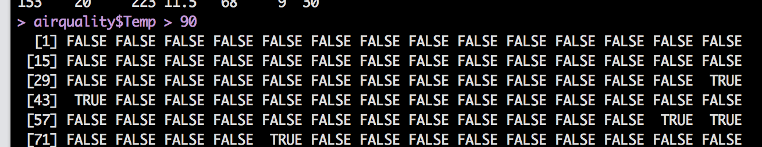
Subsetting
How does the logical operator work?
It analyzes each row/column for the appropriate logical question
So, in this example, we asked it to analyze the Temp column.
Each row was tested to see if it was greater than 90.
Try airquality$Temp > 90

Slide 69
Subsetting
Therefore, all the columns with TRUE were selected.
True = 1
False = 0
You can use this feature to your advantage when selecting for missing cases.

Slide 70
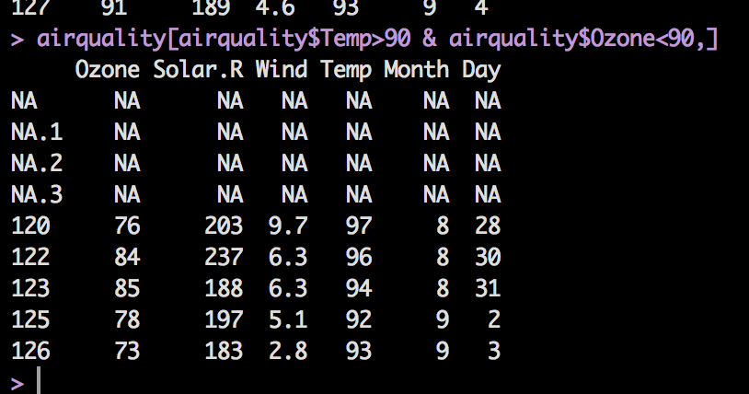
Subsetting
You can use multiple arguments to get the exact data you want.
airquality[airquality$Temp>90 & airquality$Ozone<90,]
You’ll still get NAs though, we’ll get to how to deal with them.

Slide 71
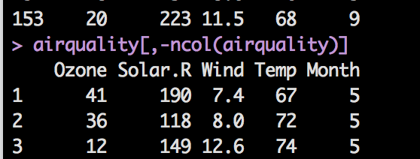
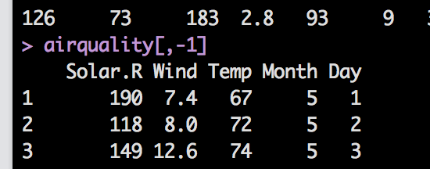
Subsetting
Let’s say you wanted everything BUT the first column
airquality[,-1]
Let’s say you wanted everything BUT the last column
airquality[,-ncol(airquality)]

Slide 72
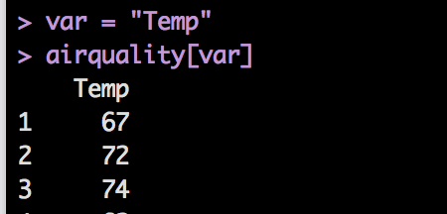
Subsetting
Something important:
When subsetting lists or dataframes, you can do this:
var = “Temp”
airquality[var]
Airquality$Temp
But not:
airquality$var
When you use the $, an exact match is expected, but the [] will fill in with the variable value.

Slide 73
Subsetting
Another subsetting function is subset()
Subset requires
(data set name, logical function)
Optional includes what columns you want to select
subset(airquality, Temp > 80, select = c(Ozone, Temp))

Slide 74
Missing Values
Missing values are considered NAs
NaN is not a number, NA is a missing value.
However, NaN sometimes is the error when you get when you try to do something with a NA.
You sometimes can get away with having them in the dataset, often not.

Slide 75
Missing Values
Many functions have options that allow you to omit them to run the function.
Not all of them, and they often do the missing omission differently.

Slide 76
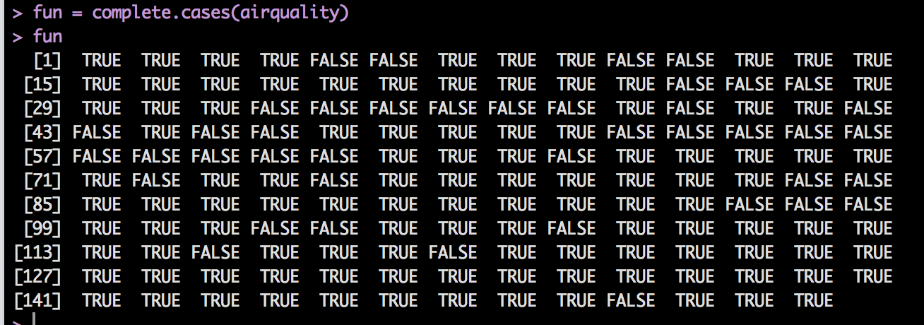
Missing Values
There are several NA functions:
But they often don’t do what you think.
complete.cases(DATA SET)

Slide 77
Missing Values
The missing values functions often return logical vectors with:
TRUE = yes missing data
FALSE = no missing data
Complete cases tells you if the entire row is complete.
TRUE = complete, FALSE = incomplete
So, how can I use it to remove the incomplete cases?

Slide 78
Missing Values
airquality[complete.cases(airquality),]
Remember that means look at the rows that have a TRUE, give me back all columns.

Slide 79
Missing Values
Another function that is faster than complete cases is na.omit()
na.omit(airquality) and airquality[complete.cases(airquality),]
Do the same thing!

Slide 80
Missing Values
is.na() works in much the same way, but works in individual values, rather than the entire row like complete cases.
Usually, you can use this function for individual columns or rows.
Is.na can help with checking for missing values in data screening.

